Slide 1
Seven Seas a Slave
The truth behind Human Rights Violations beneath Davy Jones' Locker
By: Shelby, Amanda, Kalynn, and Seth
Notes:
Shelby

Slide 2
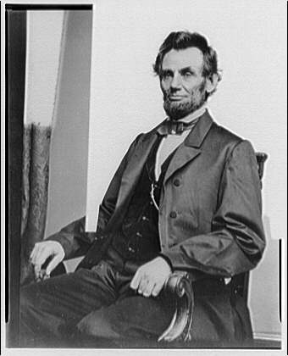
“Whenever I hear anyone, arguing for slavery I feel a strong impulse to see it tried on him personally." - Abraham Lincoln, March 17, 1865, in speech to the Union Army Regiment.
Notes:
Shelby

Slide 3
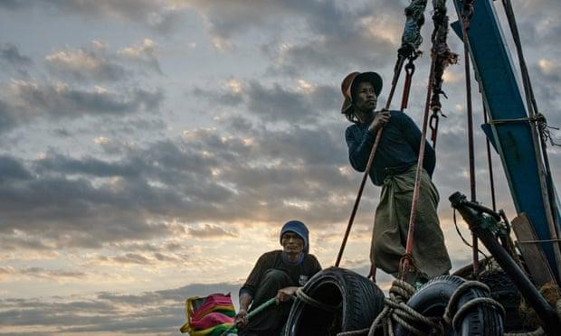
A look at the Thailand Fishery
Thailand has been recognized as the world's biggest exporter of seafood for decades,along with Europe and the United States as the biggest consumers of this seafood.
The big question as of lately is,
“Was the fish you were eating,
caught by a slave?"
Burmese migrant workers leave the port at Mahachai after unloading their catch Photograph: Chris Kelly/theguardian.com
Notes:
Shelby

Slide 4
In June of 2014, the Guardian Newspaper reported that fish caught by victims of human trafficking while working abroad Thai fishing boats, were being used to feed shrimp and have them exported for sale in freezers of the world’s top four retailers.
Approximately ten days later, the United States department of State downgraded Thailand in its annual Trafficking in Persons (TIP) report to Tier 3 (The lowest possible status). This prompted numerous media exposures that raised a serious concern about mass killings, beatings, and trafficking of migrant fishers, many from Burma and Cambodia.
Notes:
Shelby

Slide 5
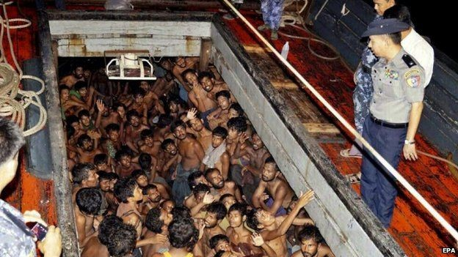
They have instilled fishing industry monitoring, control, and management regimes. However, the regimes are still weak ones. Thus posing a major problem! Without having a strong regime, we can't end slavery and trafficking within the fishing industry of Thailand.
The European Commission issued a "Yellow Card” warning to Thailand by April of 2015. When this happened, it identified Thailand as a possible non-cooperating country in fighting illegal, unreported, and unregulated (IUU) fishing. In response to the whole ordeal, Thailand's military, and The National Council for Peace and Order (NCPO) had issued more regulations.
Notes:
Shelby

Slide 6
A Look at Thailand
Dozens found guilty in Thailand in Human Trafficking Case
The New York Times
Notes:
Shelby

Slide 7
Some facts:
2013-2015 Thai government pursued charges on the same company ( Boonmark ) with evidence.
With this came a successful prosecution. Arrests, charges,and convicted the Notorious Guard ( Liam ), who was responsible for the most brutal tortures and murders on the fleet.
Most of the workers on board, were thankful that the Thai government pursued this case. However, they were mad because the trafficking charges were pursued, but not the murder ones. When many had witnessed murder firsthand.
When the Captain of this vessel was interviewed, he refused to say that he abused Burmese workers. This captain was the worst of the boonmark captains, as far as abuse goes.
“ You can find the culprits, but there are other barriers such as the local level corruption involvement of law enforcement officers in the trafficking networks.Thus making it tougher for the Thai government able to prosecute the harsher cases like murder ones.” -theoutlawocean.com/thailand-sea-slavery/
Notes:
Shelby

Slide 8
Thailand's biggest port city.
The hub of the Thai Overseas fleets ( meaning the larger vessels that go further away for longer periods of time.) These ships have the most abuse cases.
Kan Tang ( Problematic Port ) has a lot of negative attention for abuses, because the ships are the least regulated.
Notes:
Shelby

Slide 9
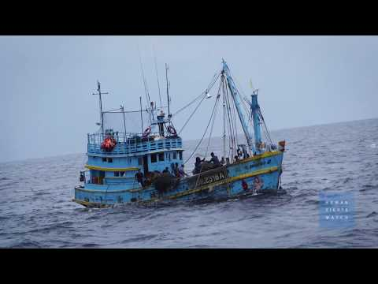
Notes:
Do a snippet of the inside of Violations
Stop at 5:30

Slide 10
Reform and what is the problem?
One of the most significant reforms is Legalization of migrant fishers’ status.
New Identity documents formally known as ( Pink Cards )
Before the reform, most migrant workers were undocumented. Pink cards protect the workers from extortion on land, and allow authorities to use a crew list to ensure and monitor a safe departure/return of fishermen.
Pink cards don’t protect the workers’ ability to escape abuse, or to witch jobs without a signed authorization from their current employer.
Thai law requires every fishermen to be paid every month, but it doesn’t happen.
All Captains hold onto worker’s pink cards for what they call, “ safe keeping.” This leaves fishermen extremely vulnerable to abuse, and harassment. Thus making it difficult for them to demand their rights.
The Reform Has FAILED! Pink cards restrict workers, more than it protects them.
Notes:
Shelby

Slide 11
The Issue.....
Thailand’s anti-trafficking law was amended 2017.
Adding additional means by which people can be placed into forced labor, like debt bondage, but this doesn’t protect the victims of forced labor who haven’t been victims of trafficking.
Notes:
Shelby

Slide 12
Recommendations
Make forced labor a stand alone criminal offense and enforce it.
Ensure Migrant Fishers have freedom of movement and the right to form a union to defend themselves.
Permit migrant fishers to easily change employers, without penalty or obstruction.
Improve PIPO (Boat) inspections and enforce labor law protections at sea.
Prevent captains and boat owners from seizing worker ID cards, withholding payments, and abusing workers.
KNOW where your food comes from!!!
Stop supporting a fishing industry, where Slave labor is present. Buy your fish from someone else.
Notes:
Shelby

Slide 13
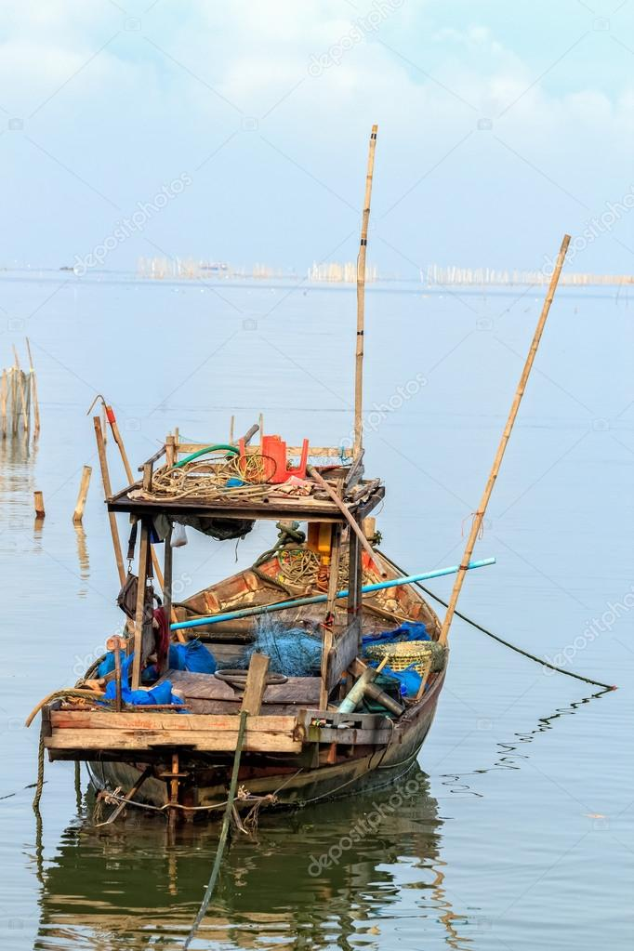
Thailand- A historical look
Up until the mid 20th century Thailand had only 65 powered boats.
The non powered boats were simple, with bamboo traps, caught mostly fish that inhabited the upper levels of the ocean.
In the 1950s trawlers were introduced but it failed to take root until the 1960s.
Notes:
Amanda reads.

Slide 14
In 1960 a joint venture between the German and Thai governments introduced inshore trawling.
In the six years that followed 1961 the number of trawlers exploded from 99 to 2,695.
Marine production increased 7 fold.
This began the process that would have a disastrous effect on Thailand’s fisheries. Once dominated by small local fishers, Thailand fisheries became dominated by powerful business people.
Notes:
Amanda reads.

Slide 15
Today
Ships are catching 14% of what they were catching in the 1960’s
With fish stocks exhausted and marine biodiversity in a crisis boats are targeting “trash fish”
A mixture of fish that are deemed unfit for human consumption and are ground up into fish meal. However, a portion of this mix does contain juveniles of fish that are economically important to Thailand.
Trash fish are ground into meal and used in aquaculture.
Notes:
Amanda reads.

Slide 16
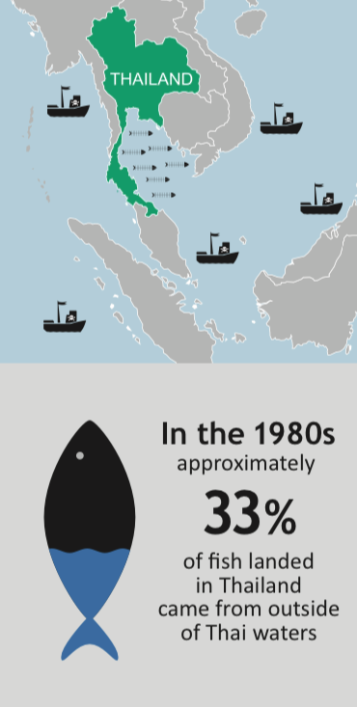
Exhaustion of fish stocks are causing vessel managers to stay out longer and search further for their prey
As far away as Madagascar and Russia.
Because of these longer voyages operators are turning to human trafficking and the slave trade.
Notes:
Amanda reads.

Slide 17
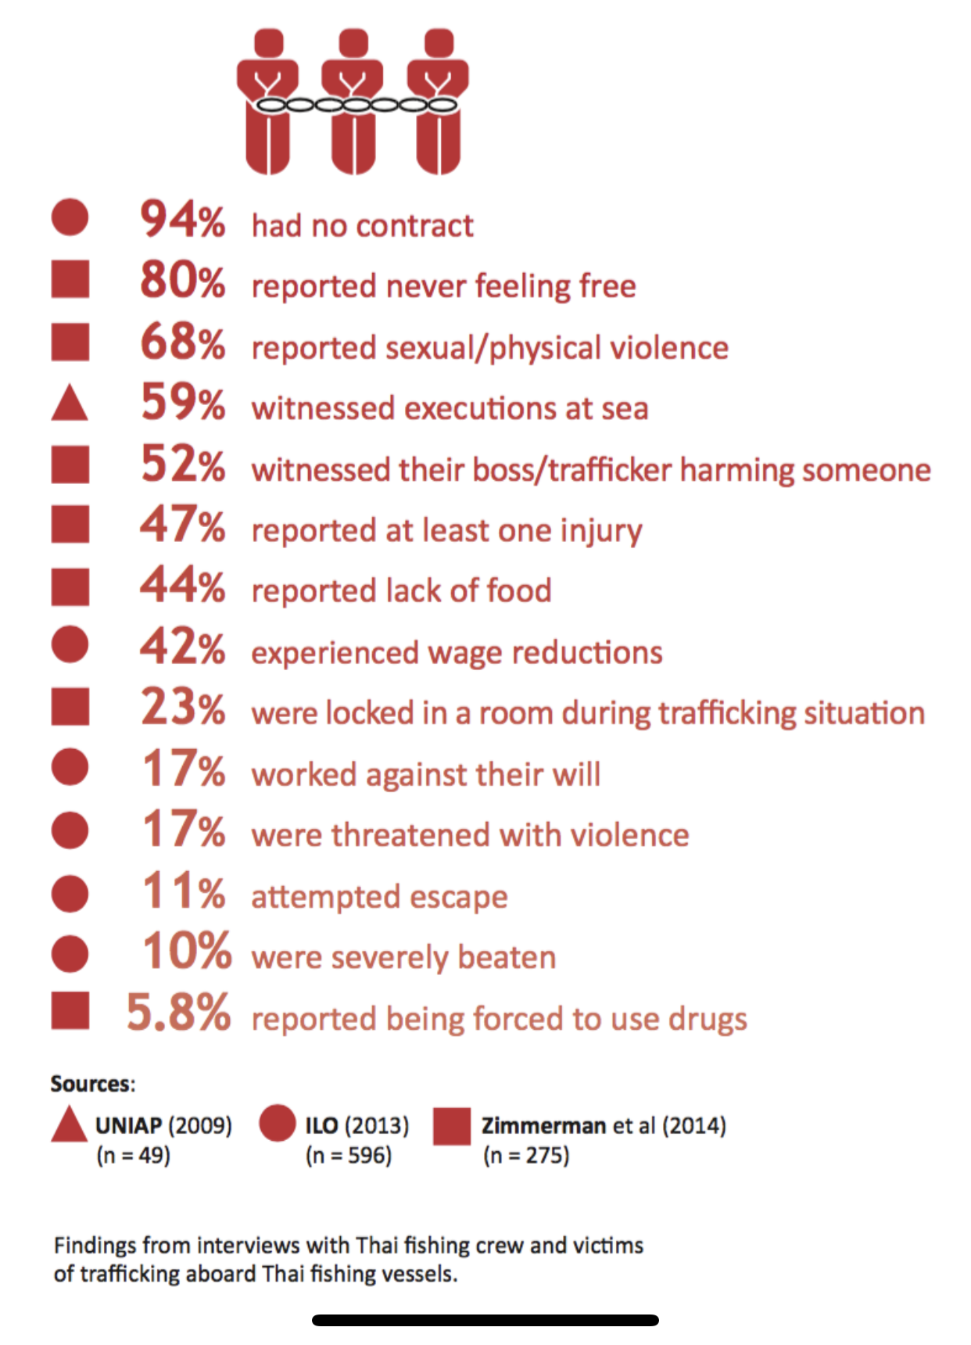
Boat captains are forcing people to work with little or no pay under the threat of violence for years sometimes DECADES at a time!!
Notes:
Amanda Reads.

Slide 18
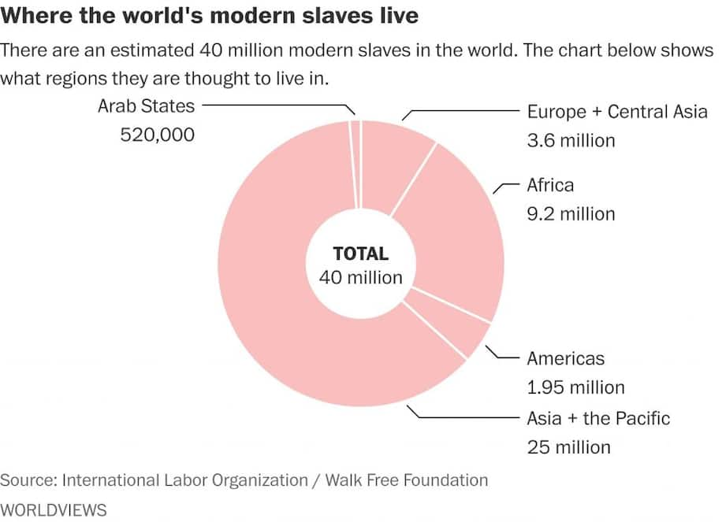
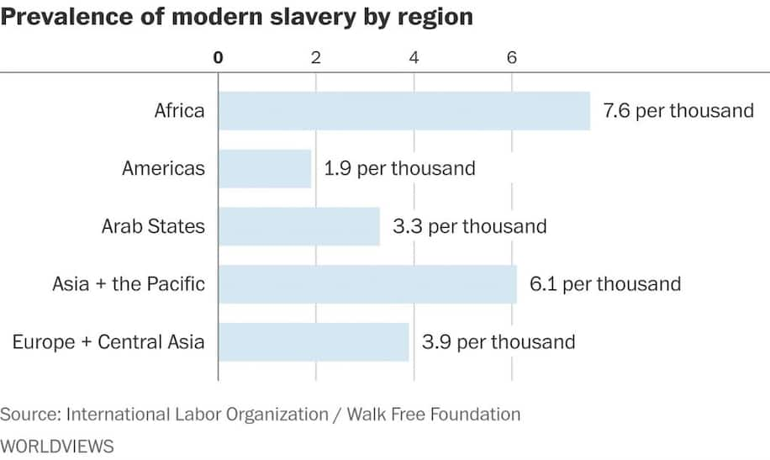
General information
4.3 million fishing vessels world wide
59% are larger, engine powered
¾ of the 59% are located in Asia
AN estimated 40.3 million people are currently enslaved
25 million of those enslaved reside in asia and the pacific
Women make up 71% of the total
1 in 4 enslaved people are under the age of 18
Thousands of these boats use slave labor in attempt to reduce costs
Many of the people enslaved in this industry are as young as 15 years old
Types of abuse:
Little to no pay
Long grueling hours
Not enough breaks for sleep
Limited time given for eating meals and basic human needs
Sexual assault
Horrific living conditions
In some cases, murder
Physically altering people as punishment
Notes:
Kalynn reads.

Slide 19
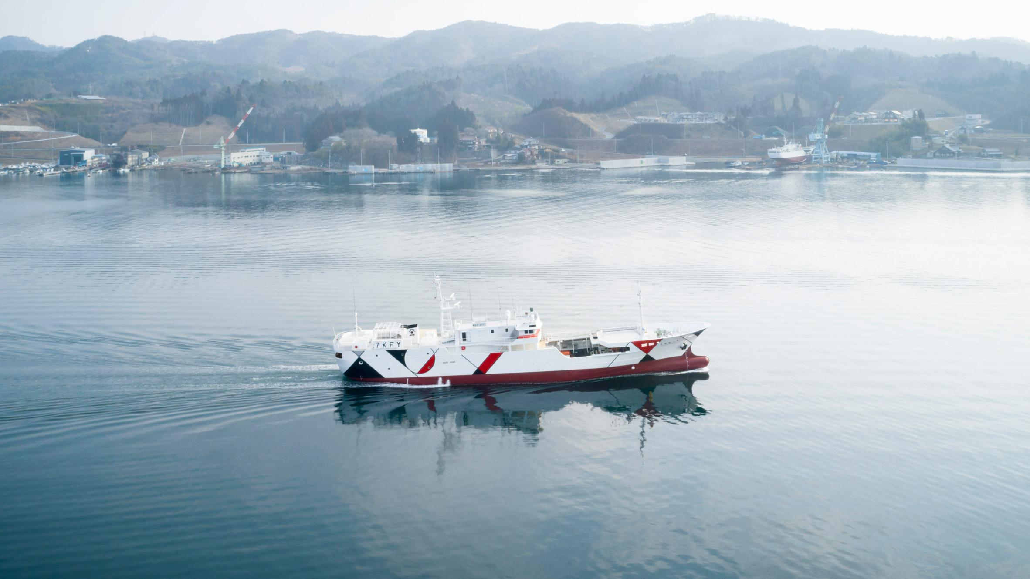
Human rights violations in japan
A majority of the workers on the vessel immigrate from Indonesia
One of the crewmates spoke out about the conditions
$375 for one month’s work, his previous highest paid month was $280
Intense lack of sleep, only 3 hours of rest for one day
Japan’s decline in available workers led to revised immigration laws in April of 2019
300,000 blue-collar workers were able to find reliable jobs
Human rights violations that were exposed after April of 2019
Less than minimum wage pay
Unethical amount of work hours
Forceful deportation if they refuse to work or try to speak out against these conditions
Unhygienic work spaces and living areas
Some workers felt that the only escape was taking their own lives
Notes:
Kalynn reads.

Slide 20
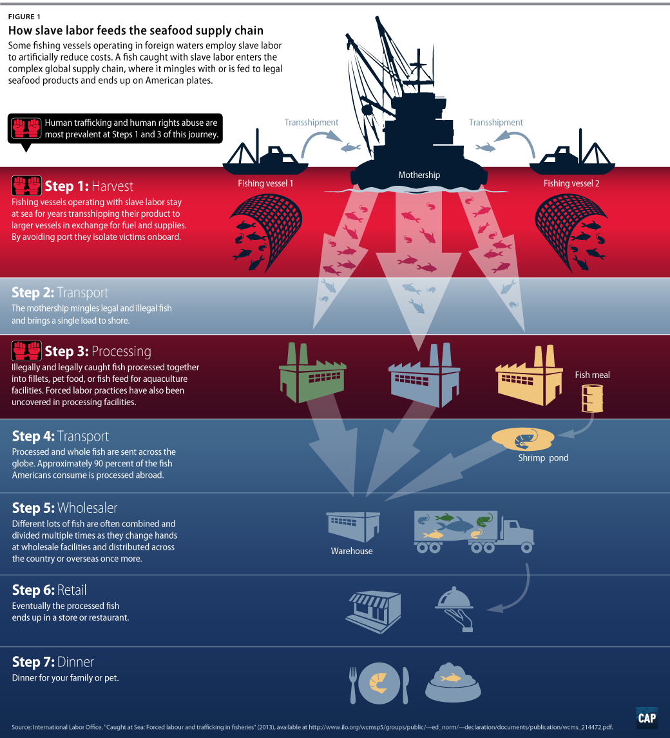
https://vimeo.com/368797707
(Sutton & Siciliano, 2016)
Notes:
Kalynn reads.

Slide 21
Women’s Rights Violations in Fisheries
Part of the problem with human rights violations in fisheries involves gender inequality and gender inequality. To begin talking about these issues that impact fisheries, we need to find the difference between gender equality and gender equity.
Notes:
Seth reads.

Slide 22
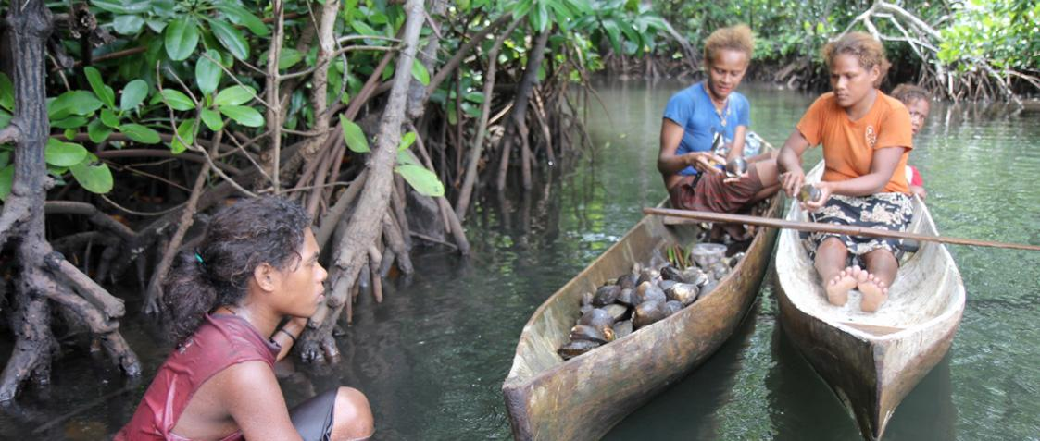
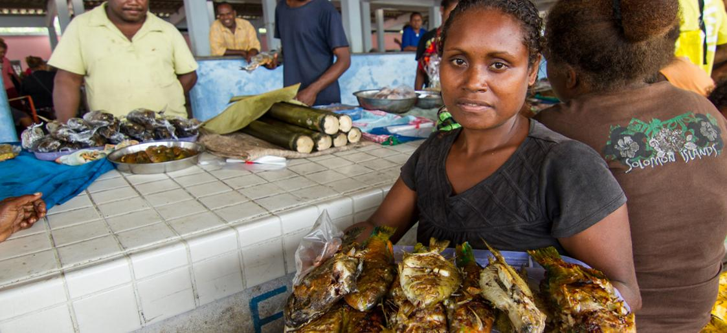
What separates them is that gender equality is about ensuring that men and women have the same opportunities and resources, but gender equity is an effort to correct the restrictions that society has placed on women due to gender roles and traditions. Women don’t have the same opportunities and access to resources that men do, especially in developing countries.
Notes:
Seth reads.

Slide 23
In an article for World Fish, researchers discovered that, “[in Bangladesh, only four percent of women versus 21 percent of men engage in early-stage entrepreneurial activity. These imbalances suggest that women may be making lower income returns from entrepreneurship in fisheries and aquaculture as well,” and this issue illustrates how working in fisheries is more difficult for women than men, due to the lack of resources and opportunities that are available for women. A fight for gender equity would put an end to the limited access that women have in fisheries.
Notes:
Seth reads.

Slide 24
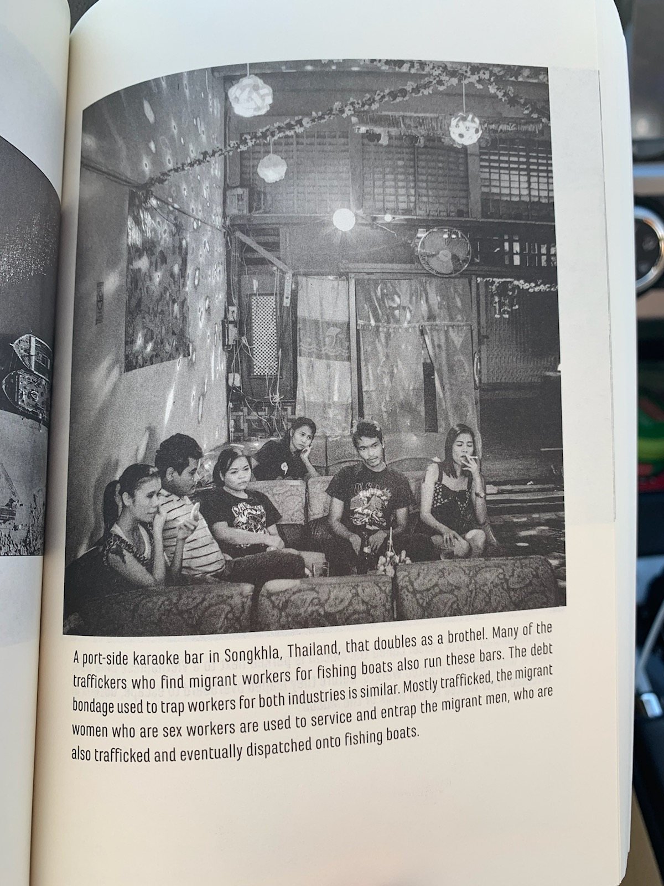
A port-side karaoke bar in Songkhla, Thailand, that doubles as a brothel. Many of the traffickers who find migrant workers for fishing boats also run these bars. The debt bondage used to trap workers for both industries is similar. Mostly trafficked, the migrant women who are sex workers are used to service and entrap the migrant men, who are also trafficked and eventually dispatched onto fishing boats. -From the Outlaw Ocean book
Notes:
Seth reads.

Slide 25
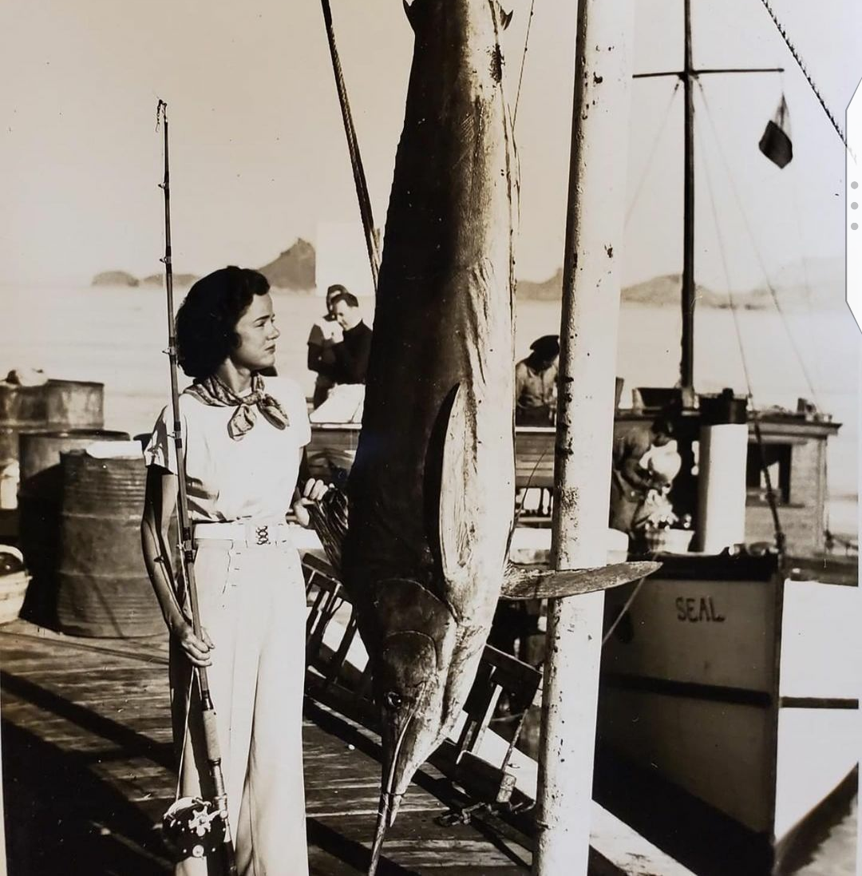
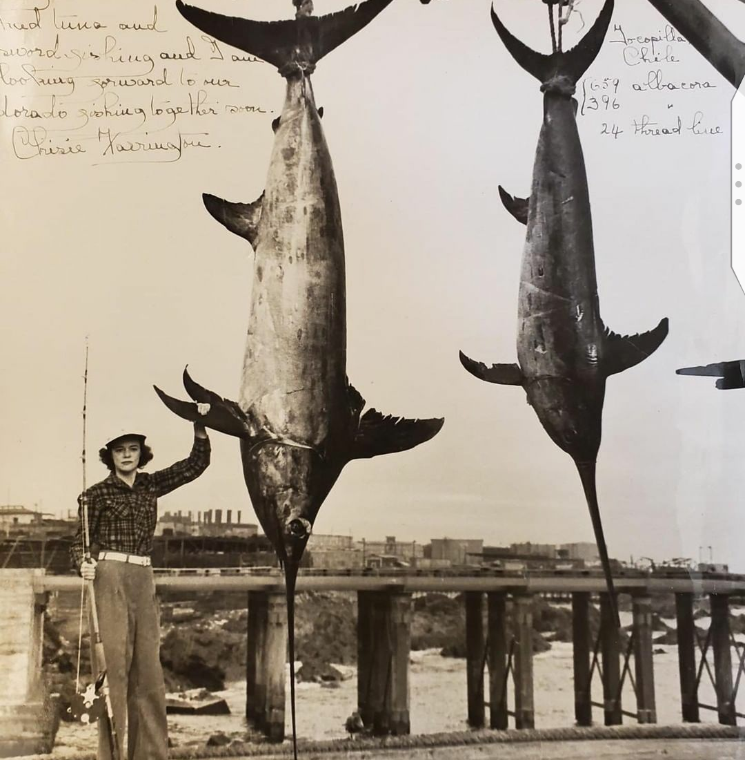
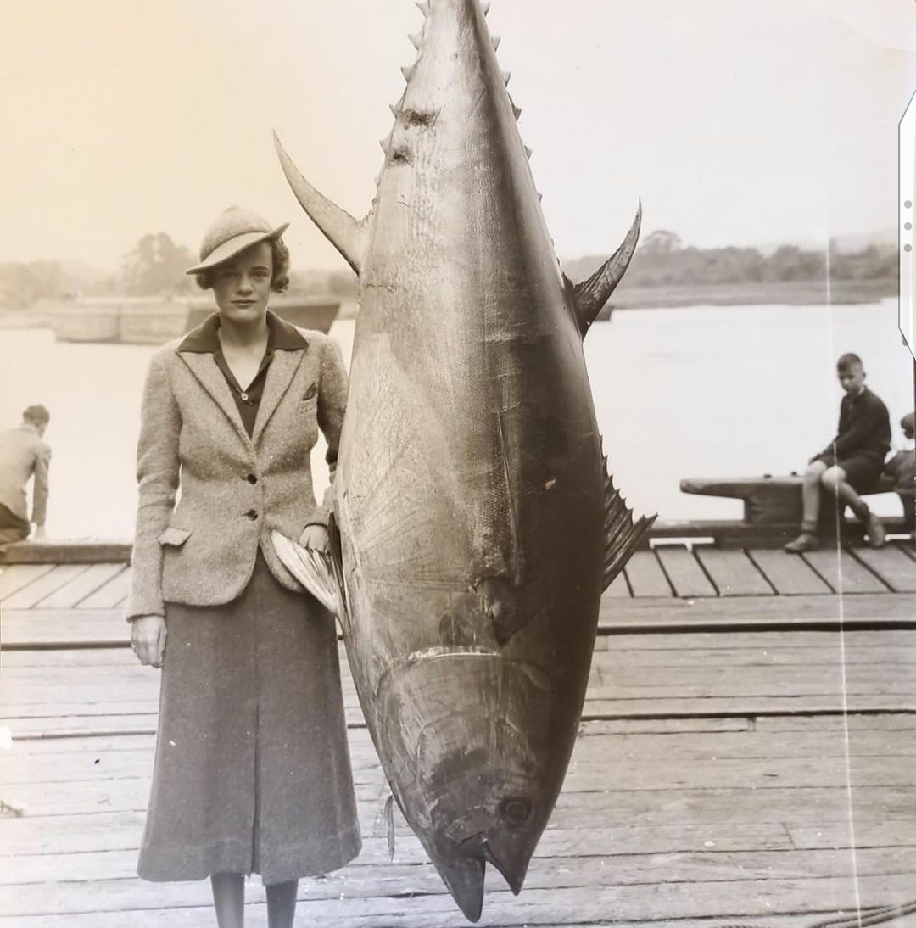
Fun Fact!
Sara Farrington
She wrote a book in 1951 called, “ Women Can Fish.”
Farrington proved that she could compete with any angler. In 1998, the IGFA inducted her into the IGFA Fishing Hall of Fame, and throughout her career she earned 11 IGFA World Records! She was the first Woman to catch a tuna on a rod and reel, the first woman to catch two Marlin in one day, and the first Woman to land two broadbill swordfish in one day, weighing in at 396 lbs. And 659 lbs.
Notes:
Seth reads.

Slide 26
Concerns:
In the case of Thailand, weak regime for enforcing human trafficking laws
Thailand will not be able to slow or reverse their depletion of marine resources.
For Japan the lack of immigrants could continue to put pressure on the fishing industry forcing operators to turn towards slave labor.
Lack of opportunities for women in developing countries.
Notes:
Amanda reads

Slide 27
Recommendations Continued:
Know where your seafood comes from.
Stronger government regimes.
Stop targeting “trash fish”.
Improve working conditions in Japan for blue collar workers.
Gender equality in fisheries.
Notes:
Amanda reads.

Slide 28
Let’s Shed some Light...
We should care as consumers of knowing where our seafood actually comes from.
We think that the only way to proceed in society is to have stricter laws and have them actually being enforced. If there is a lack of enforcers, then we need to have outside enforcers step in. Such as other countries like “ The United States “, if need be.
Notes:
Amanda reads.

Slide 29
References:
Thailand: Sea Slavery. http://www.the outlaw ocean.com/thailand-sea-slavery/
Hidden Chains: Rights Abuses and Forced Labor in Thailands Fishing Industry (2018) http://
how.org/report/2018/01/23/hidden-chains/rights-abuses-and-forced-labor-Thailand’s-fishing-
industry#_ftn4
Human Rights Watch. (2018) http://youtu.be/8FbrfgRmfly
Ian Urbina. Lawless Ocean: The Link Between Human Rights Abuses and Overfishing. (2019)
https://e360.yale.edu/features/lawless-ocean-the-link-between-human-rights-abuses-and-
overfishing
Environmental Justice Foundation. Pirates and Slaves: How Overfishing in Thailand Fuels
Human Trafficking and the Plundering of Our Oceans http://un-act.org/publication/view/
pirates-slaves-overfishing-thailand-fuels-human-trafficking-plundering-oceans.
Environmental Justice Foundations. Human Rights Abuse in the Tuna Industry. (2019) http://
factsanddetails.com/japan/cat24/sub159/item937.html#chapter-13.

Slide 30
Mile ski, J.P., Galvan, C.B., & Forester, Z.D. (2019) Human trafficking in the commercial fishing
industry: A multiple case study analysis. Marine Policy, 116. Https://www.sciencesdirect.com/
science/article/pii/S0308597X19300533.
Human Rights Watch. Japan Events of 2019. HTTPS://www.how.org/world-report/2020/
country-chapters/japan#
Sutton, T., & Siciliano, A. (2016). Seafood Slavery. A Center for American Progress. Https://
www.American progress.org/issues/green/reports/2016/12/15/295088.seafood-slavery/
Why Gender Equality Matters in Fisheries and Aquaculture. Worldfish.
www.worldfishcenter.org/pages/why-gender-equality-matters-fisheries-aquaculture/

